Slide 1
Zanmi Kafe: Data Description

Slide 2


Slide 3
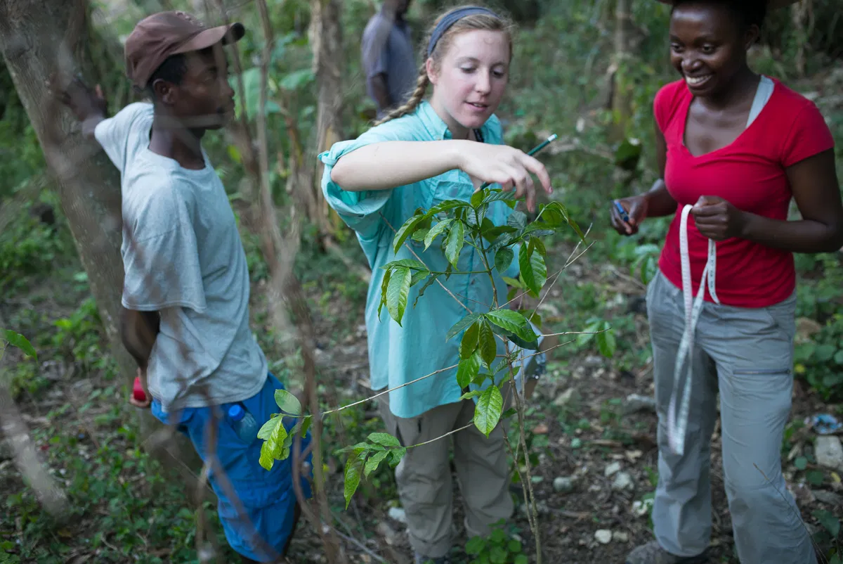
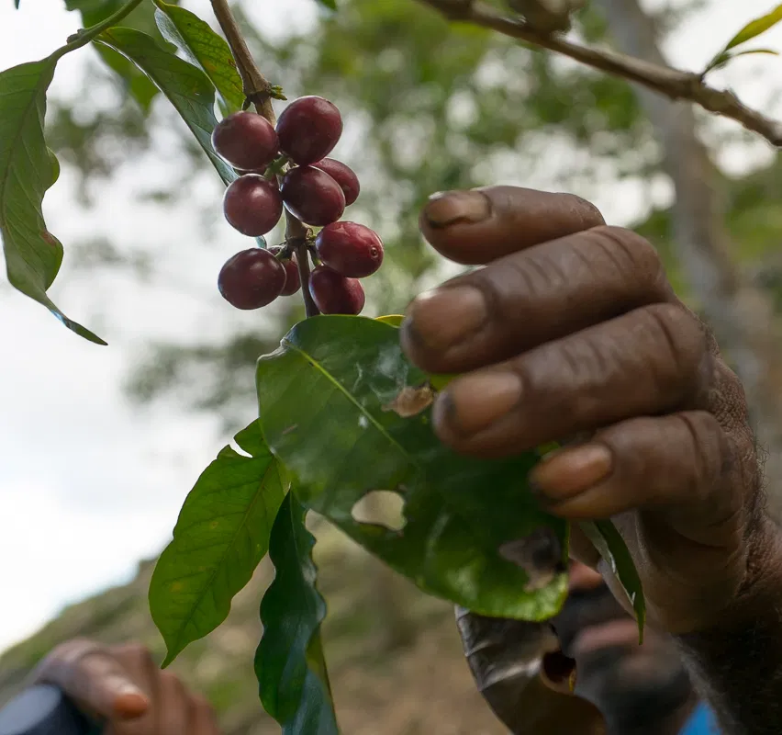
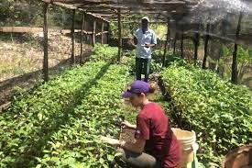
Provenance
DATA ORIGIN:
Originally collected by Outreach Trip students and input into Google Sheets by Dr. McGrath and Rehan Ali
Our datasets were shared with us by our client, Dr. McGrath
Private data

Slide 4
Data Sets
2019
Farm summary
Carbon estimates
Carbon payments
2021
Farm summary
(Carbon will be calculated by our team)

Slide 5
2019 Data Sets: Valuable Models
Data Estimates
Demonstrates original process and equations used to calculate carbon sequestered by tree, farm, and species
Carbon Payments
Records the carbon price used, amount paid by Sewanee
Farm Summary
Change in number of trees and in growth

Slide 6
“ZK Tree Survey 2021”
Individual tree measurements
Classified by farm (Household)
Includes tree species, height, and diameter
Presence (Y/N) of coffee cherries
Survey team
Travel restrictions means remote collaboration
Very fun, spontaneous, and wacky format! 👍

Slide 7
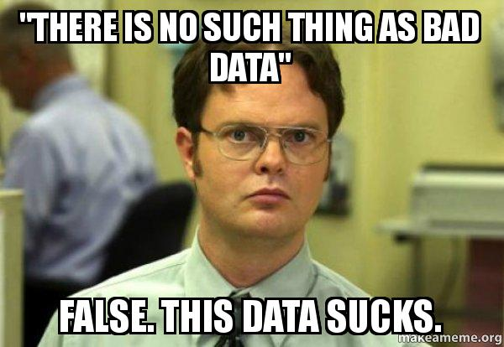
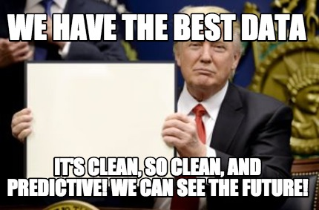
… but we are going to fix it!

Slide 8

Thanks for not laughing!
Questions?

